Slide 1
An algorithm for modularity analysis of directed and weighted biological networks based on edge-betweenness centrality
Jeongah Yoon, Anselm Blumer1 and Kyongbum Lee
BIOINFORMATICS Vol. 22 no. 24 2006, pages 3106–3108
Presenter: Chiao-Wei Chiu (邱喬偉)
Date: May 16, 2007

Slide 2
Abstract
Motivation: Modularity analysis is a powerful tool for studying the design of biological networks, offering potential clues for relating the biochemical function(s) of a network with the ‘wiring’ of its components. Relatively little work has been done to examine whether the modularity of a network depends on the physiological perturbations that influence its biochemical state. Here, we present a novel modularity analysis algorithm based on edge-betweenness centrality, which facilitates the use of directional information and measurable biochemical data.

Slide 3
Introduction
Light: recent studies have suggested that these sub-networks correspond to biologically meaningful, functional units or ‘modules’
Measures of centrality:
  degree,
  closeness
  betweenness - best

Slide 4
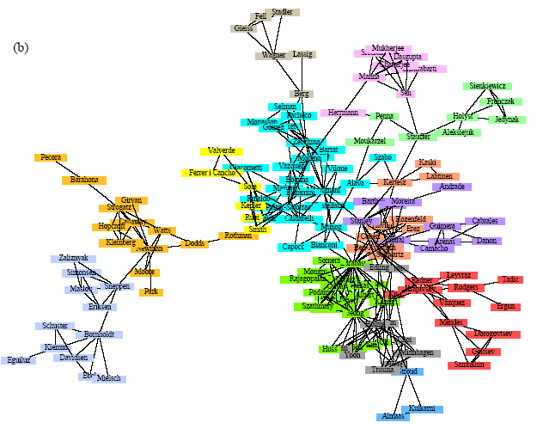
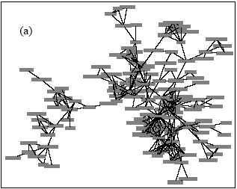
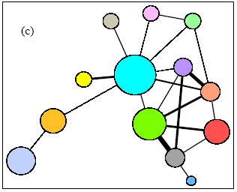
Illustration
圖片出處: Finding and evaluating community structure in networks.
A network of coauthorships between
physicists who have published on topics related to networks.
90/145 of scientists are in smaller components.

Slide 5
Background
σ_{st}(v): number of shortest paths from s to t that contains the vertex v
σ_{st}: number of shortest paths from s to t
b_{st}=σ_{st}(v) / σ_{st} : probability that vertex v falls on a randomly selected shortest path connecting s with t
betweenness centrality: sum of (σ_{st}(v) / σ_{st} ) for all pairs (s, t), s≠t≠v

Slide 6
Edge-betweenness centrality
sum of (σ_{st}(e) / σ_{st} ) for all pairs (s, t), s≠t

Slide 7
Algorithm
Step 1: Dijkstra’s algorithm
  outputs: a shortest path number matrix (Ssigma), a predecessor matrix (Ppred), and a shortest distance matrix (Ddist)
Step 2: edge-betweenness centrality index is calculated for all edges
  The edge with the highest index value is removed, forming a new, potentially modular, graph representation of the original network

Slide 8
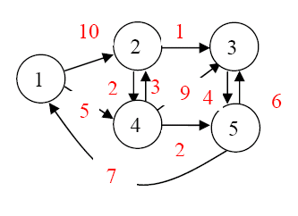
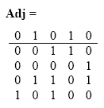
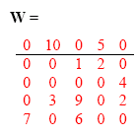
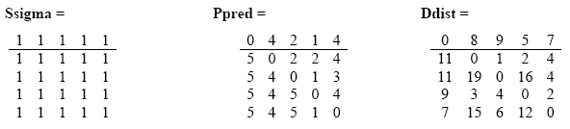
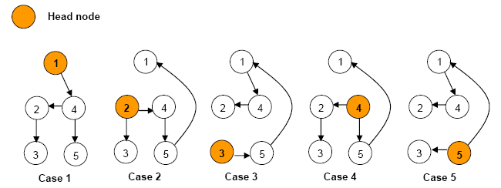
Example (Step 1)

Slide 9
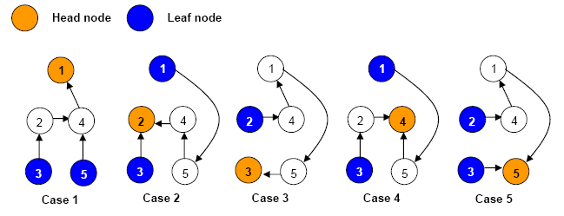
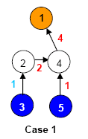
Example (Step 2)
reversed graphs

Slide 10
Time Complexity
In the worst case, steps 1 and 2 will require, respectively, O(nm + n²logn) and O(nm) steps per edge removal.
At completion, when all edges have been removed, the algorithm will have executed m · [O(nm + n²logn) + O(nm)] steps.

Slide 11
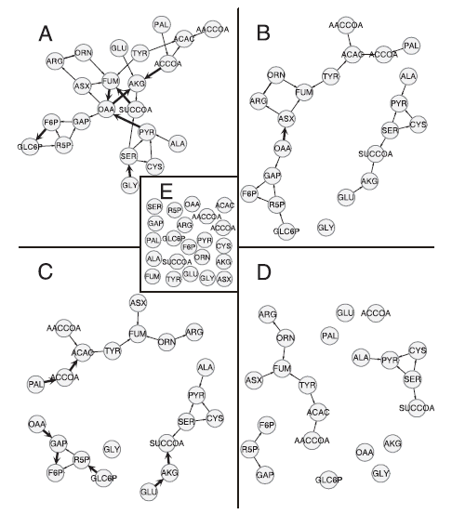
Result
Modularity analysis of central carbon metabolism in the fasted rat liver (22 internal metabolites, 50 reactions). Metabolites were represented as nodes, and reactions as edges.
(A) original network
(B) view 5
(C) view 6
(D) view 8
(E) view 9
Run on P4 with a CPU 2.53GHz and RAM 0.5 GB,
the calculations required nine iterations and lasted 8 to 9 s,
indicating an average run time of 1 s per iteration.

